Slide 1
Final Project Update
Kyle white and jordan

Slide 2
Museum Update
Changed to Jacksonville Music History Museum
Lack of Space in the Eartha White Museum
Lack of Detail
Lack of Opportunity
No LiDAR scans
Build Everything from Scratch
Creative opportunity

Slide 3
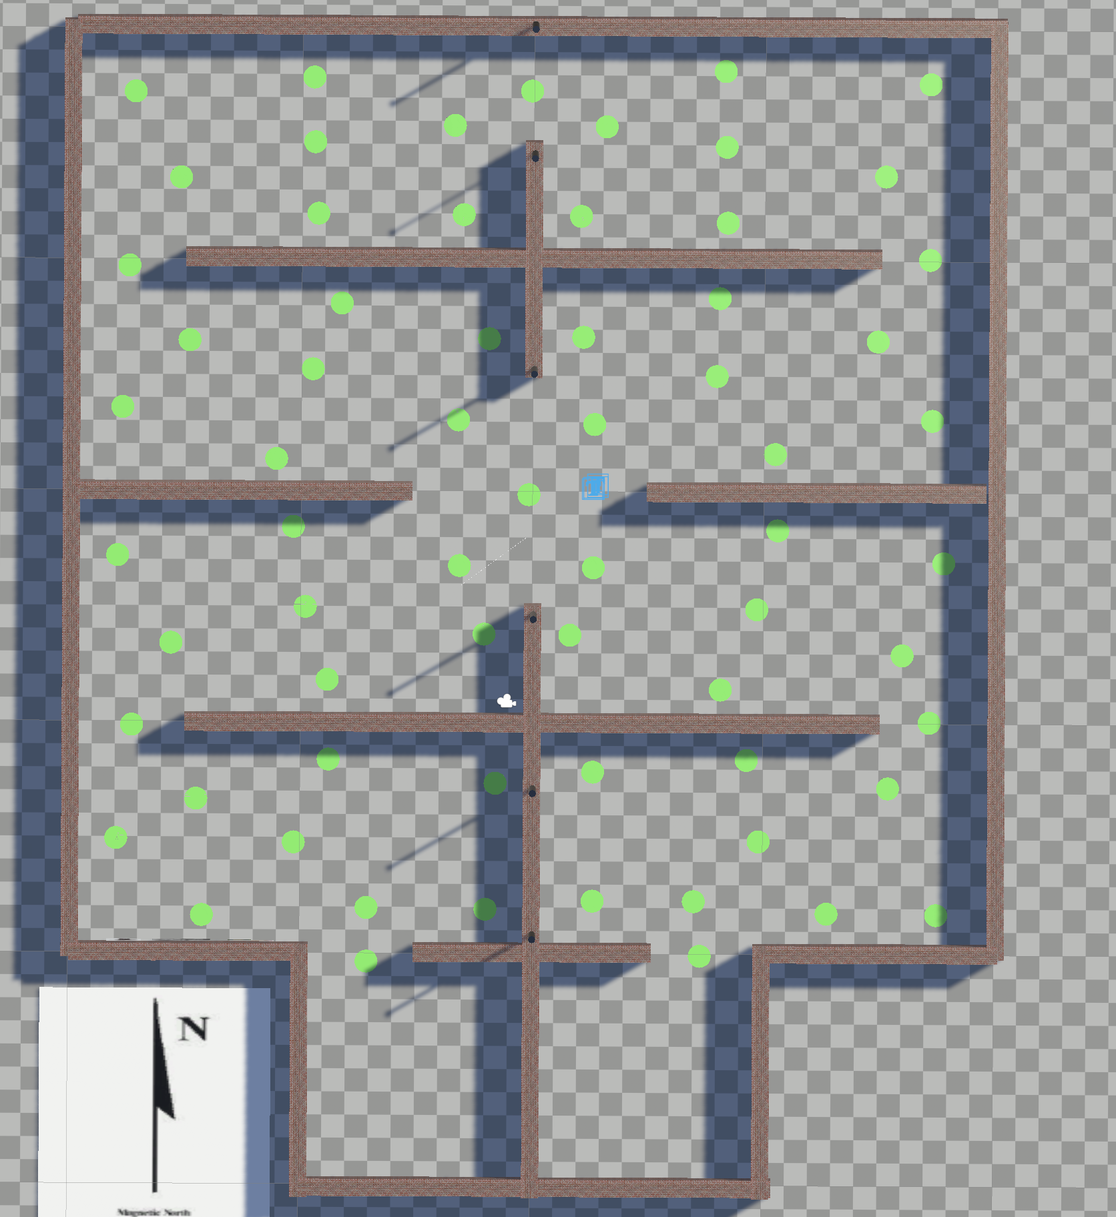
Layout of the Museum
No physical Location
Layout design
Graph Navigation
Allows for the user to quickly
navigate through each exhibit
and choose a specific exhibit
“Walking through the
Evolution of Music”

Slide 4
Information
Summaries of each musician has been typed up
Still must be imported into Unity
Must also have a way to Cite sources of information
Display information in best way (HUD)

Slide 5
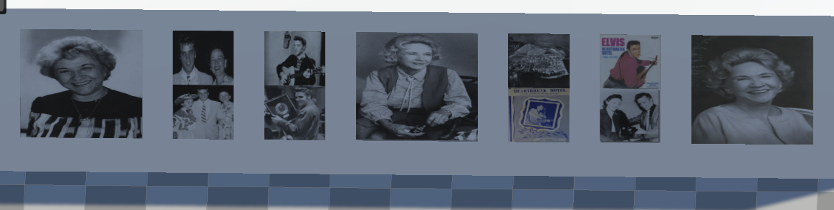
Pictures
Provide pictures of Artists and Bands
Gives users better idea of time periods and styles
“Walking through the Evolution of Music”
Helps Users put information to faces
Also will Implement Videos of Performances

Slide 6
Next Steps (Kyle)
Add Music to Exhibits
Only Plays When User is Within that Exhibit
Add Videos to Exhibits
Incorporate Videos so Users can Hear and See live performances
Add Assets to Exhibits
Guitars, Drums, Speakers, Microphones

Slide 7
HUD
Current version only has periods on the right
Intention is to have break out menu’s on the right displaying exhibits

Slide 8
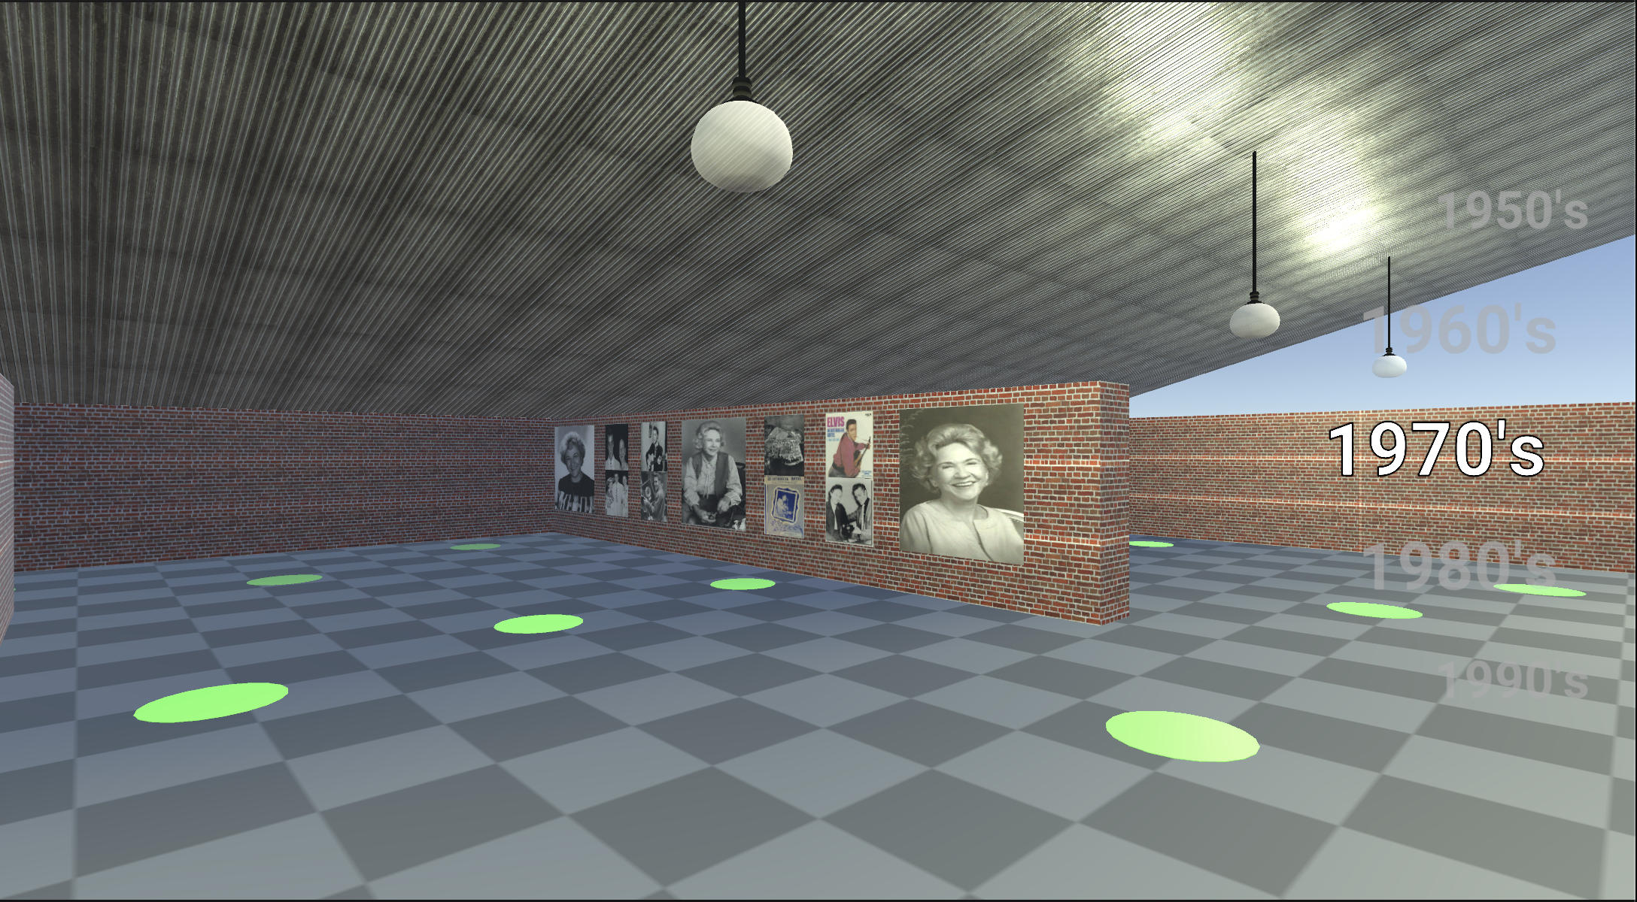

Slide 9
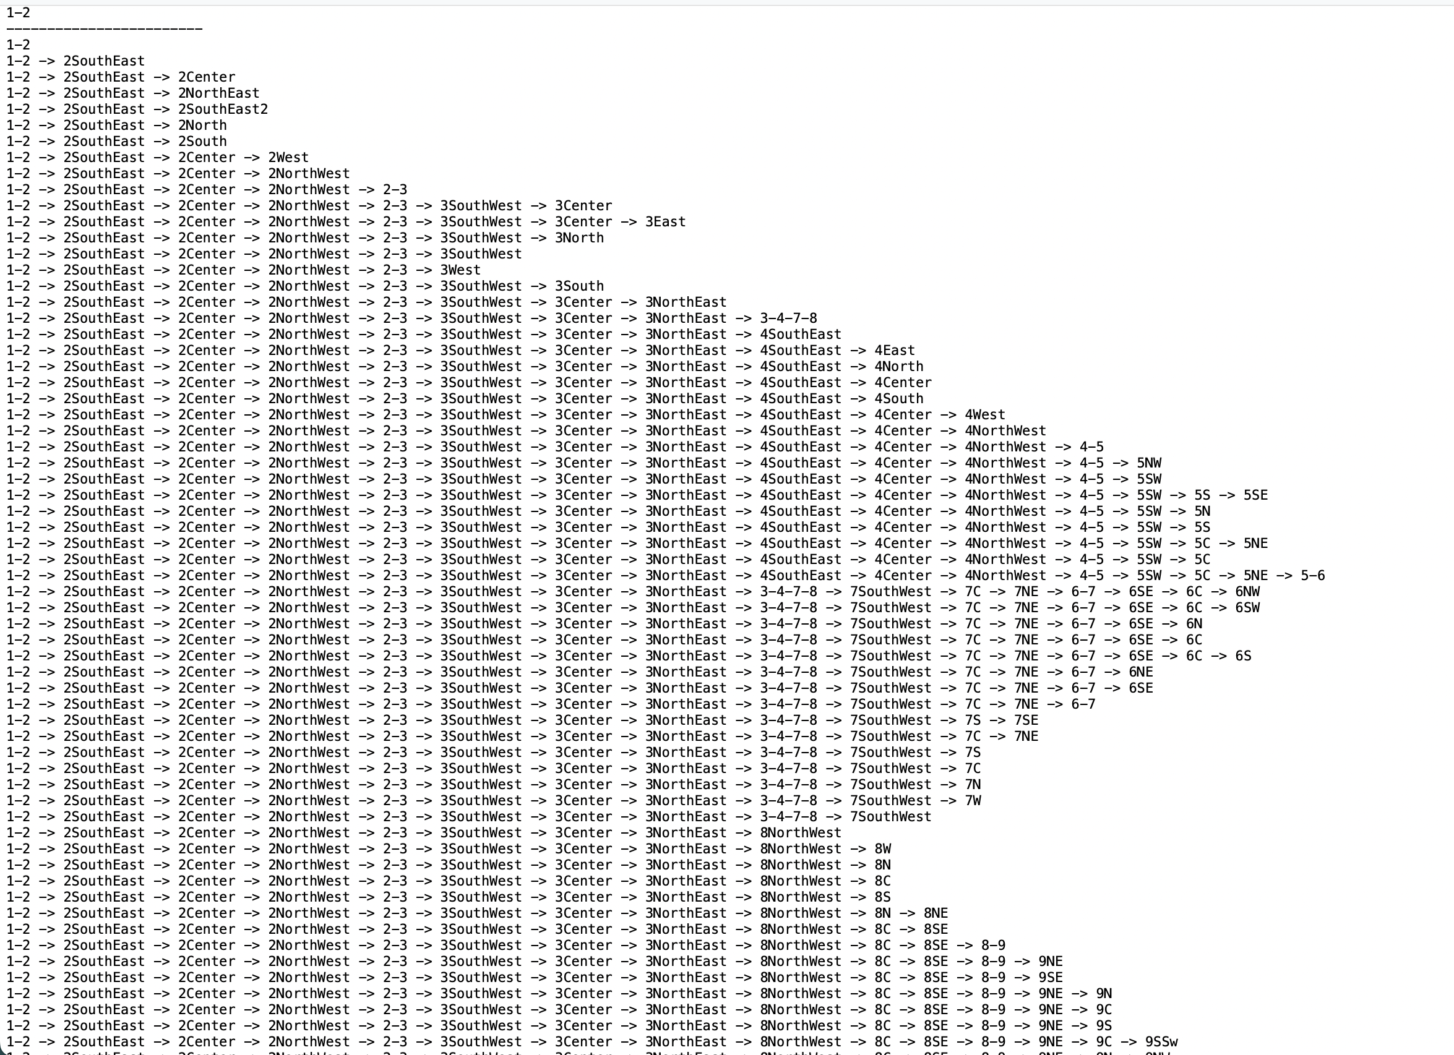
Shortest Path
Algorithm to determine shortest path from any node to all other nodes (Dijkstra’s Algorithm) functional
Current Issues:
User select node to travel to
Line renderer

Slide 10
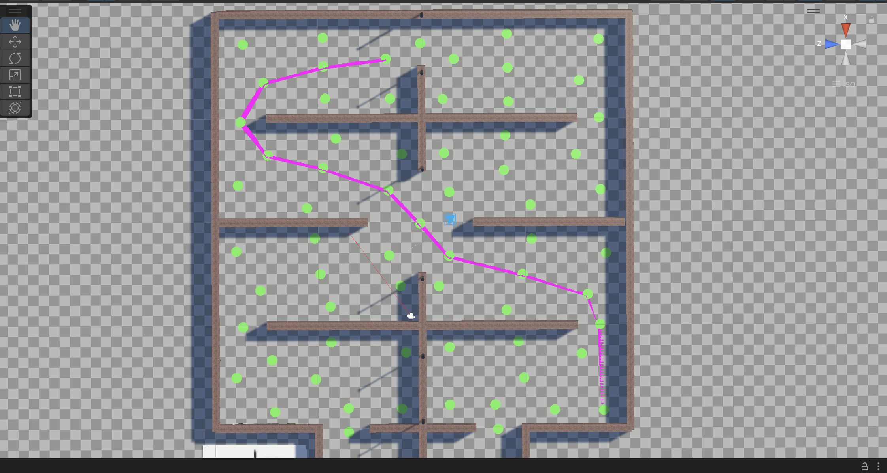

Slide 11
